Slide 1
AR Streaming 360 Display
SIFT
Scale-Invariant Feature Transform
Dennis Simon
Chen Lan, Michael Josh Dangcil, Chris Peng, James Medel
Advisor: Harry Li
San Jose State University

Slide 2
SIFT and Minor History
Created by David Lowe in 1999 and developed by David Lowe in 2004.
Patented by University of British Columbia.
Image descriptor used for image-based matching and recognition.
Five major steps
SIFT uses Difference of Gaussian to find keypoints.
Keypoints refined for accuracy and low-contrast keypoints and edge keypoints are removed leaving strong keypoints.
Orientation assigned to keypoints to create invariance to image rotation.
Keypoint descriptor created by taking neighbourhood around keypoint epresented as a vector.
Keypoints between images are matched by identifying nearby neighbourhoods.
For more info see: http://opencv-python-tutroals.readthedocs.io/en/latest/py_tutorials/py_feature2d/py_sift_intro/py_sift_intro.html
Notes:
Graphical representation missing

Slide 3
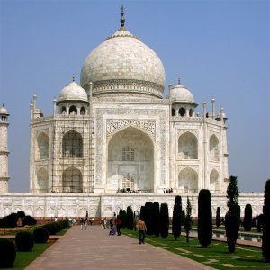
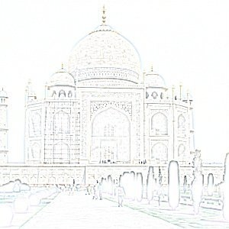
Difference of Gaussians (DoG)
DoG maxima/minima at multiple scales are used to generate keypoints for SIFT
DOG is used to identify edges
Approximation of Laplacian of Gaussian which takes longer
Two different Gaussian blurs with different blur amounts performed on an image
Subtract both to yield result
Amount of blur is called sigma
Notes:
Gaussian blur used in image proessing and is result of blurring function by gaussian function
Used to reduce image noise and reduce detail generally, creates a smooth blur

Slide 4



DoG Mathematics
DoG of Image I is function:
Obtained by subtracting I with Gaussian blur of σ₂ ² from I with Gaussian blur of σ₁ ² where σ₂ > σ₁
In a one dimensional case the formula is:
In a centered two dimensional case the formula is:

